Slide 1
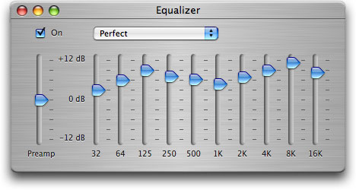
Equalisation

Slide 2
Equalisation
Definition
Boosting or cutting certain frequency components in a signal
Equalisation (EQ) is a form of filtering
Filters are class of systems that change magnitudes and phases of input signal in a frequency-dependent manner
Usually linear and time-invariant
Origin
Trying to obtain flat frequency response
No colouration
Example
Transmitting analogue voice signal over long distance
Transmission line attenuates high frequencies
Apply equalisation filters to correct loss, resulting in more natural sound on the other end
Notes:
Equalisation (EQ) is the process of boosting or cutting certain frequency components in a signal. The name originates from the application of trying to obtain a flat frequency response - no coloration. For example, when transmitting (analog) voice signals over long distances of wire, the high frequencies would be attenuated. By applying some equalisation filters, this loss could be 'undone' so that the voice would sound more natural on the receiving end. Equalisation is a very important tool in recording for bringing out an instrument's sound.

Slide 3
z-transform and delay theorem
Recall the z-transform
When z= e^{jω} we can find the frequency response
Normalised radial sampling frequency ω=2πf/f_{s}
Suppose we know the z-transform of a sequence
Z[{x(n)}]=X(z)
Then Z[{x(n-1)}]=z⁻¹X(z), … Z[{x(n-N)}]=z^{-N}X(z)
So we can write delays in block diagrams in the Z domain
x[n]
x[n-1]
z⁻¹
X(z)
unit
delay
z⁻¹X(z)

Slide 4
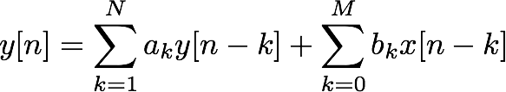
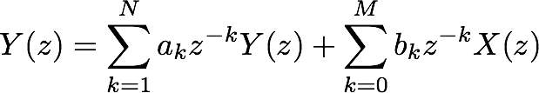
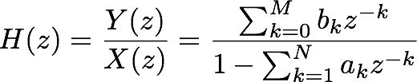
z-transform of a digital filter
From the delay theorem
Filter can be completely described by coefficients
a1, ..., aN, b0, b1, ..., bM

Slide 5
Simple digital filter
A digital filter can be described many different ways.
Difference equation (time domain):
y[n] = a y[n -1] + x[n]
Transfer function (frequency domain):
H(z)=Y(z) /X(z)=(1-az⁻¹)⁻¹
Block diagram
Algorithm (software)
x[n]
y[n]
+
a
z⁻¹
loop()
{
read x
y = a * y + x
write y
}

Slide 6

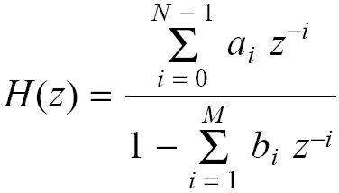
General digital filter
General difference equation
Take z-transform of both sides
Transfer function
If b_{i}=0, for all i,
No feedback
finite impulse response (FIR) filter
If b_{i}≠0, for any i,
Feedback
infinite impulse response (IIR) filter
Calculating output
z-transform of input
X(z)=Z[{ x(n)}]
Multiply by transfer function
Y(z)=H(z) X(z)
Take inverse z-transform
{y(n)}=Z⁻¹[Y(z)]

Slide 7
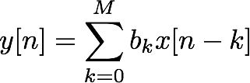


FIR and IIR
Consider filters of the form
Output a sum of the last M inputs
Finite impulse response:
If , for n > M
Properties of FIR filters
Linear
Time-invariant
Always stable for any (finite) coefficients
x[n]
z⁻¹
z⁻¹
z⁻¹
z⁻¹
z⁻¹
z⁻¹
...
b0
b1
b2
b3
b4
b5
b6
+
y[n]

Slide 8
FIR and IIR
More general form:
Output depends on last M inputs and N outputs
Infinite Impulse Response (IIR)
Unless all ak = 0
Often N = M in practice, but this is not required
max(N,M) called order of filter
Properties of IIR filters
Linear
Time-invariant
Stability depends on coefficients ak
Most equalisers use IIR filters

Slide 9
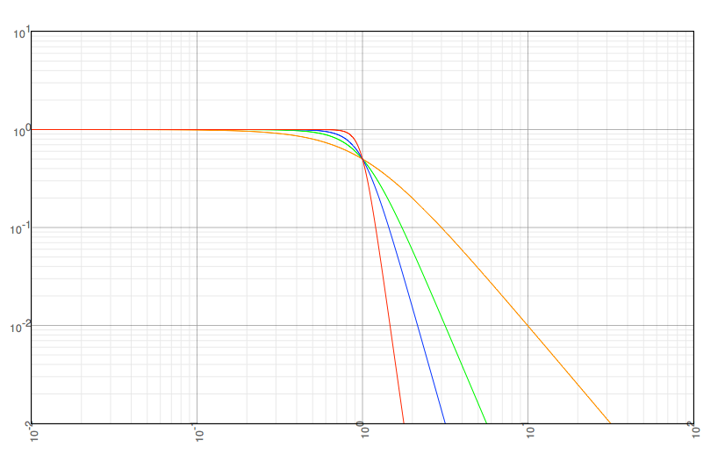
What do we want in a filter?
Generally two conflicting priorities:
Sharpness of cutoff
Between passband and stopband
Computational complexity
Measured in multiplies per sample
Butterworth
(IIR) filters
Order
N = 1
N = 2
N = 3
N = 6
log(H)
Rolloff:
6N dB/octave
log(f)

Slide 10



What do we want in a filter? (part 2)
For equalisers, sharpest cutoff not necessary
Small, controlled adjustments to frequency response
Advantages of IIR
More computationally efficient (lower orders)
Models analogue filters
Advantages of FIR
Always stable
Linear phase (when coefficients are symmetrical)
symmetrical impulse response means...
magnitude change with delay means...
phase is a linear function of frequency

Slide 11
Direct realisation of a digital filter
Feedforward
Feedback
Notes:
OPTIONAL
The block diagram of a digital filter is illustrated.

Slide 12
Direct realisation of a digital filter
Shift Registers
Weighting /
Coefficients
Notes:
OPTIONAL
The block diagram of a digital filter is illustrated.

Slide 13
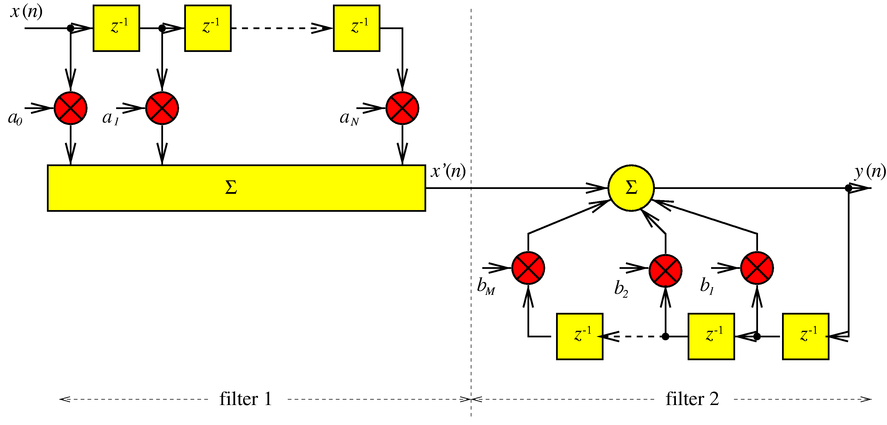
Filter structures- Canonical Form
canonical form of digital filter - realisation which requires minimum memory to implement particular transfer function
Start with direct form
Intermediate output
Notes:
OPTIONAL
The direct form is the simplest realisation or architecture for a digital filter. The canonical form of digital filter is the realisation which requires minimum memory to implement particular transfer function.
x’(n) is the intermediate output which is the input to the second filter. Since both are linear, it doesn’t matter which is first. So we can use filter 2 followed by filter 1.

Slide 14
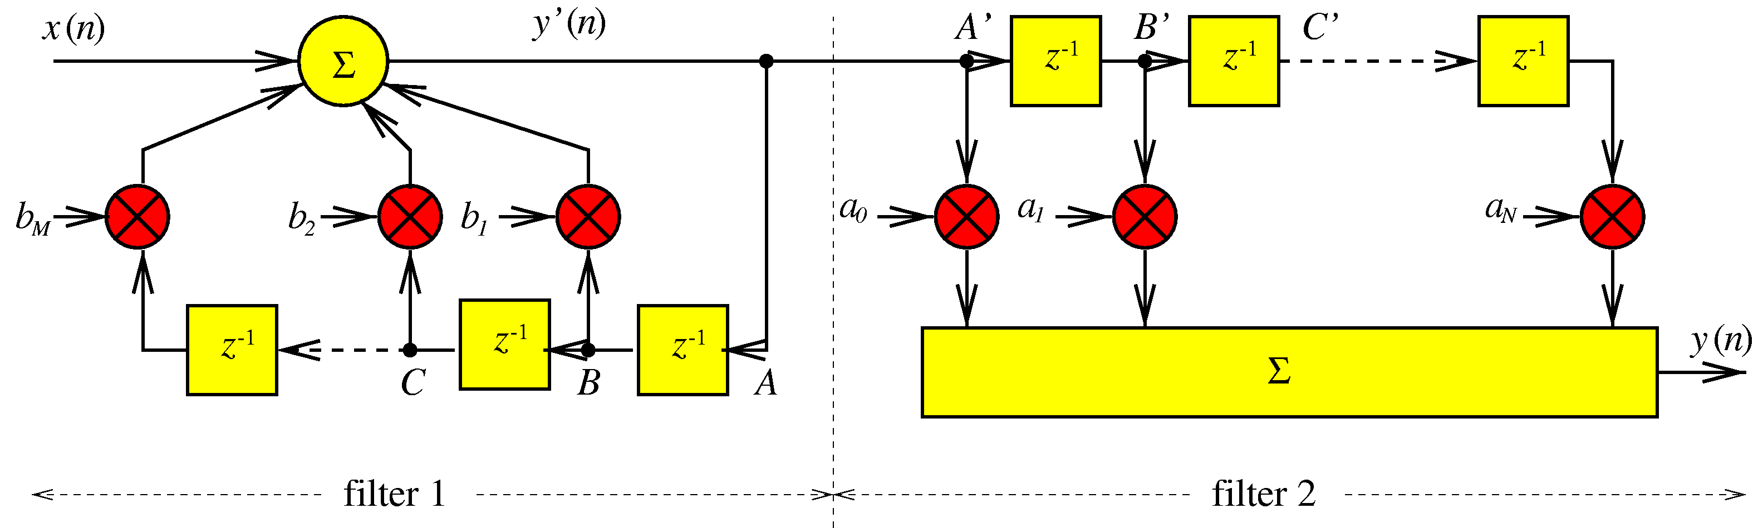
Filter structures- Canonical Form
canonical form of digital filter - realisation which requires minimum memory to implement particular transfer function
Filter 2 first instead of filter 1
Redefine filter 1:
So filter 2 is now:
Notes:
OPTIONAL
So we use filter 2 first instead of filter 1. But note that the delay structure is the same. Now note that the signal at A is the same as at A’ and at B is the same as at B’.Delay line structures are the same so they can be combined.

Slide 15
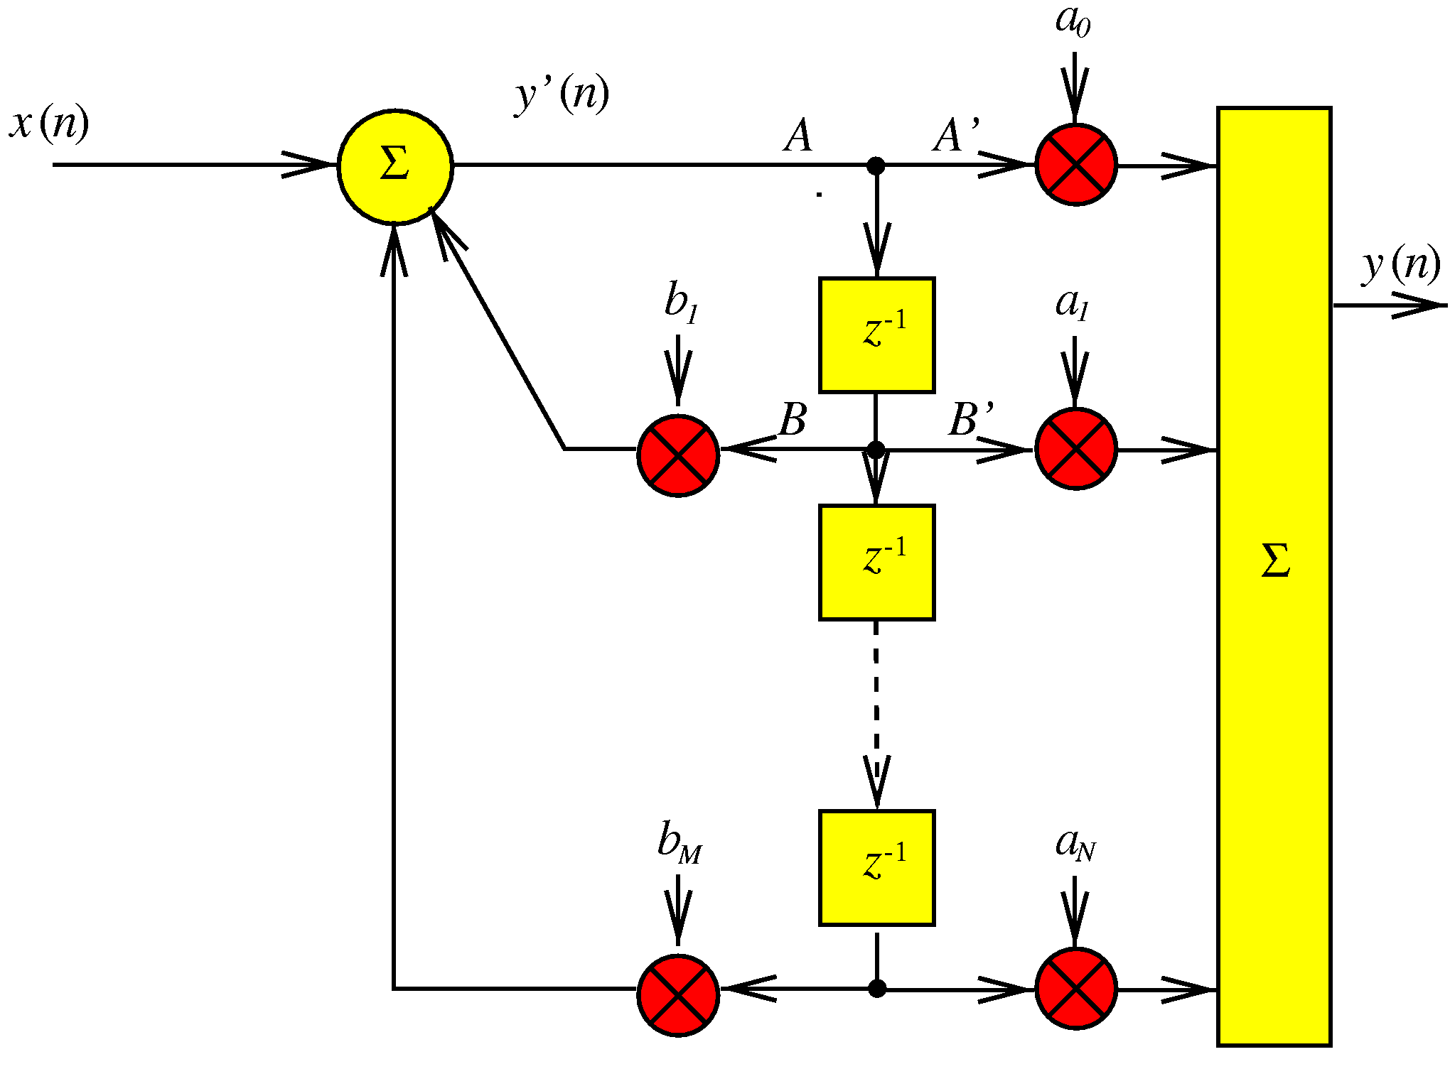
Filter structures- Canonical Form
canonical form of digital filter - realisation which requires minimum memory to implement particular transfer function
Minimum Storage Filter Implementation
Remove redundancy- canonical form
Notes:
OPTIONAL
Combining delay lines gives the canonical form.

Slide 16
Implementation
Filters can be implemented in direct form (I and II)
Configuration of delays and multiplies
x[n]
b0
+
y[n]
z⁻¹
z⁻¹
b1
+
-a1
z⁻¹
z⁻¹
b2
+
-a2
...
...
...
bN
+
-aN
Direct form I
Can be an unequal number of b and a coefficients
(for any IIR filter, not dependent on implementation)

Slide 17
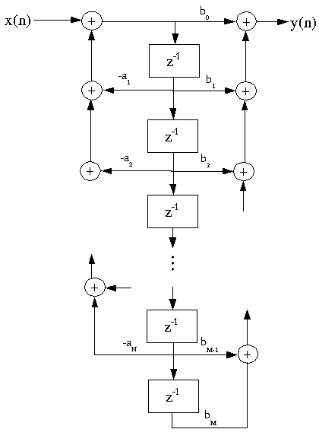
Implementation
Filters can be implemented in direct form (I and II)
Configuration of delays and multiplies
Direct form II
Coefficients (multiplies) shown
on graph edges
Image: http://cnx.org/content/m11919/latest/

Slide 18
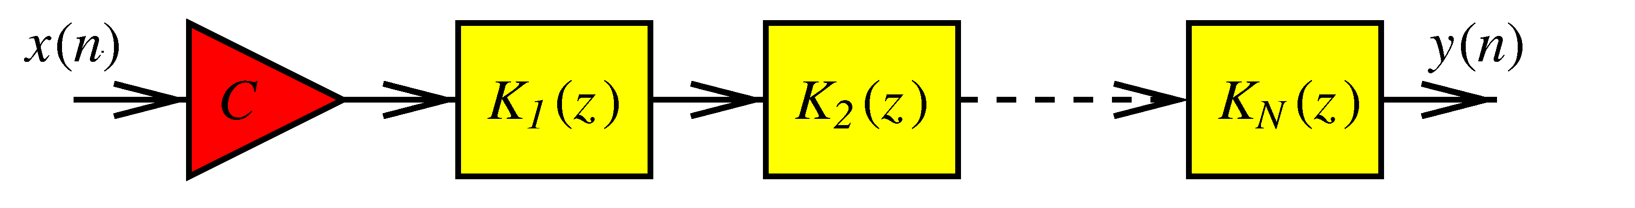
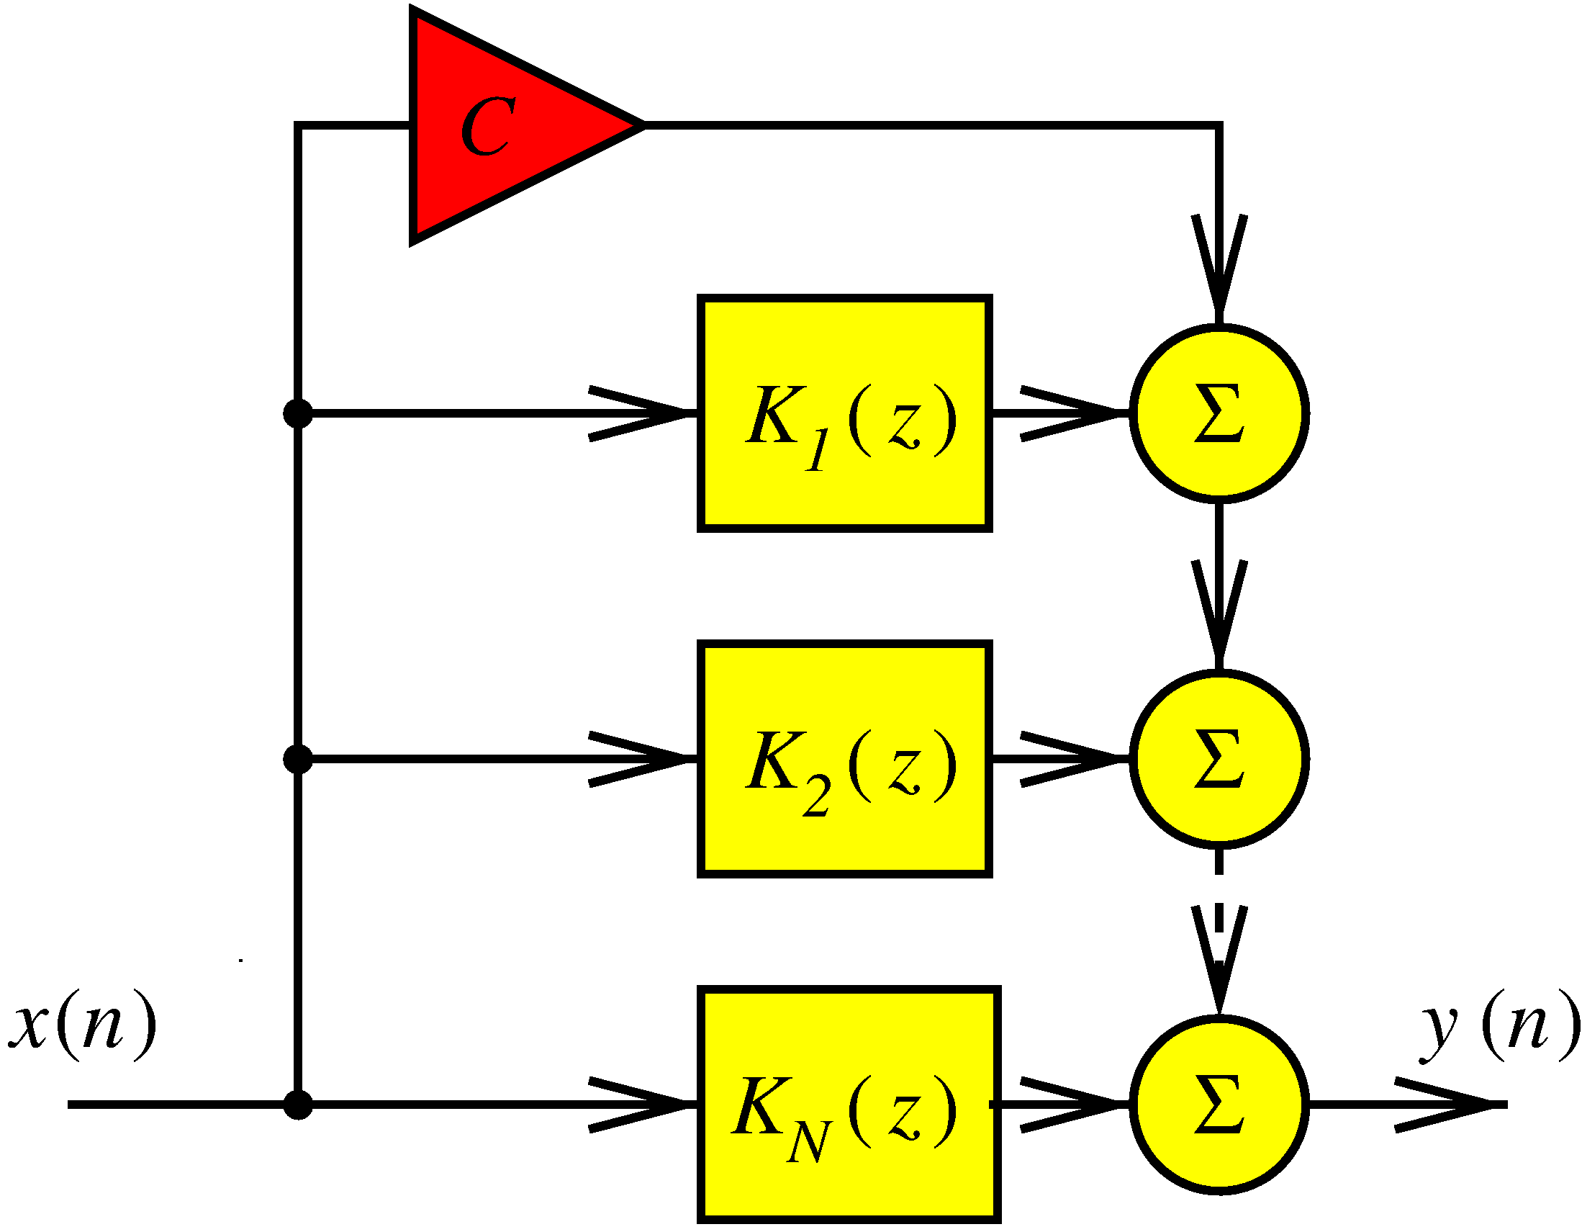
Parallel & Cascade Realisations
2 other significant digital filter realisations
Typically lower order filters
Build filter from 1st/2nd order blocks
Series cascade realisations
Factorize transfer function as product of 2nd order terms
Parallel connection realisations
Write transfer function as partial
fraction expansion of 2nd order terms
Parallel less sensitive to filter coefficient errors
Notes:
OPTIONAL

Slide 19
Biquadratic digital filter section
high-order digital filter synthesised as either series cascade or parallel connection of 2nd order sections
2nd order sections implemented as biquads
biquadratic filter == canonical second-order system

Slide 20
Arranging filters
For equalisation
Change some frequencies, but leave others unchanged
Use multiple filters
Combine the effect of each filter
Both parallel and series implementations
Series: filter responses are multiplied
shelving and peaking filters
Parallel: filter responses are added
Lowpass, highpass, bandpass filters
X(z)
H1(z)
H2(z)
H3(z)
Y(z)
H1(z)
X(z)
H2(z)
+
Y(z)
H3(z)

Slide 21
Ideal filters
|H|²
B
|H|²
1
Lowpass
1
Bandpass
0
ω_{c}
π
0
ω_{c}
π
|H|²
Highpass
|H|²
B
Bandstop
1
1
0
ω_{c}
π
0
ω_{c}
π

Slide 22
Ideal filters
|H|²
|H|²
Low Shelving Filter
G
G
Peaking Filter
1
1
0
ω_{c}
π
0
ω_{c}
π
|H|²
High Shelving Filter
|H|²
G
Notch Filter
1
1
G
0
ω_{c}
π
0
ω_{c}
π

Slide 23
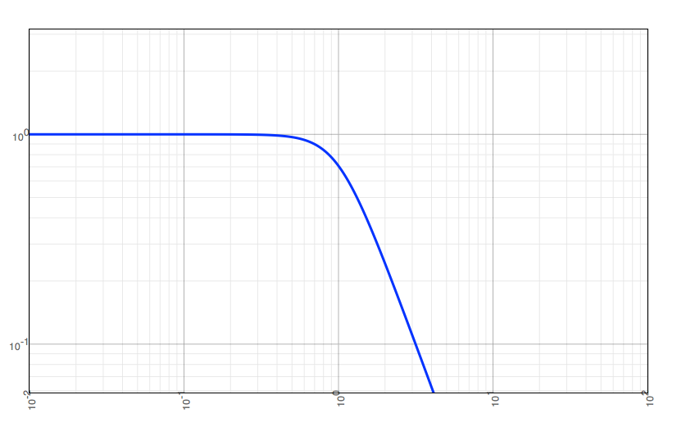
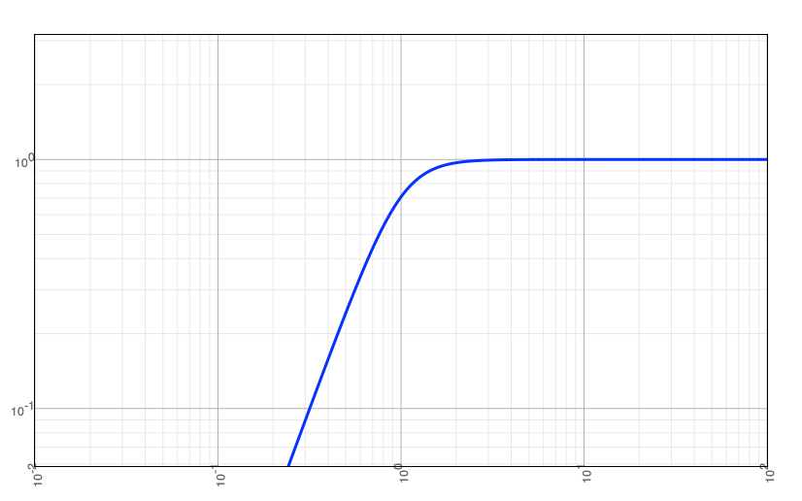
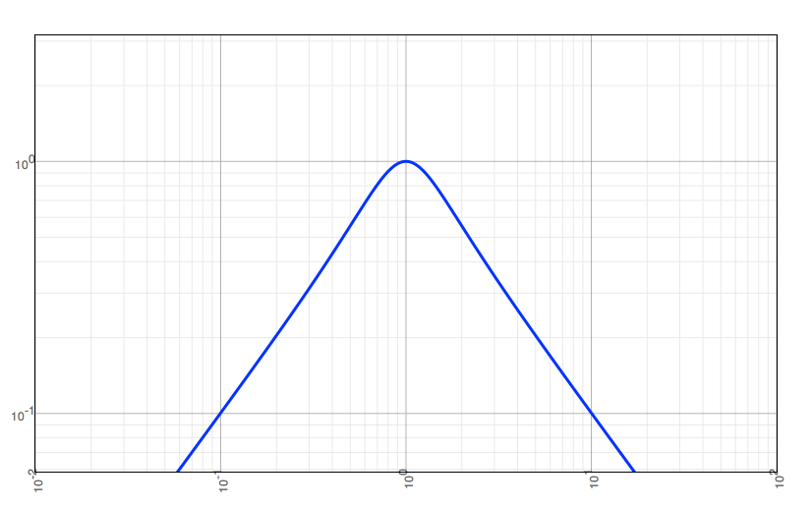
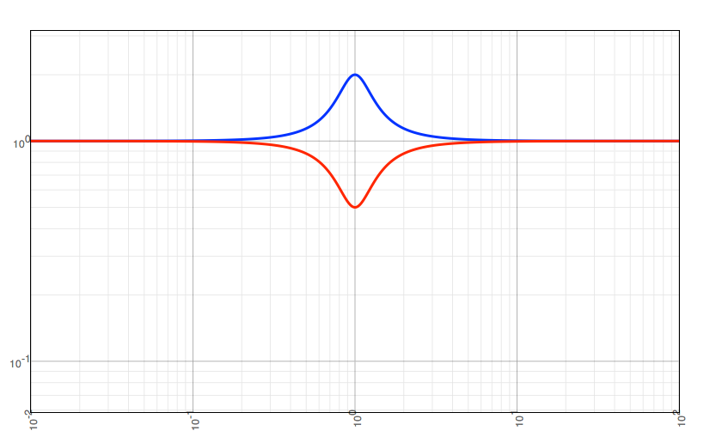
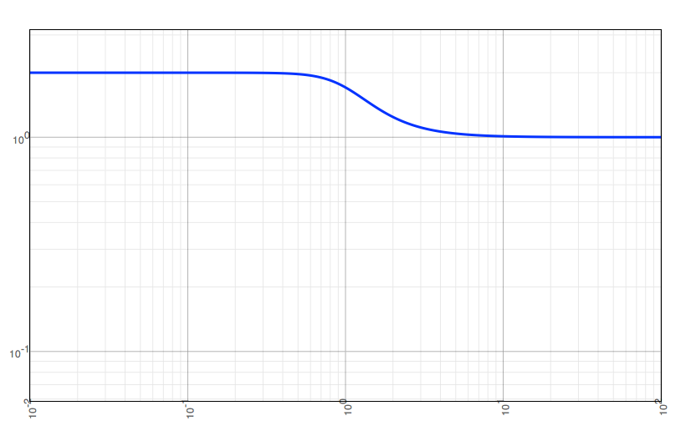
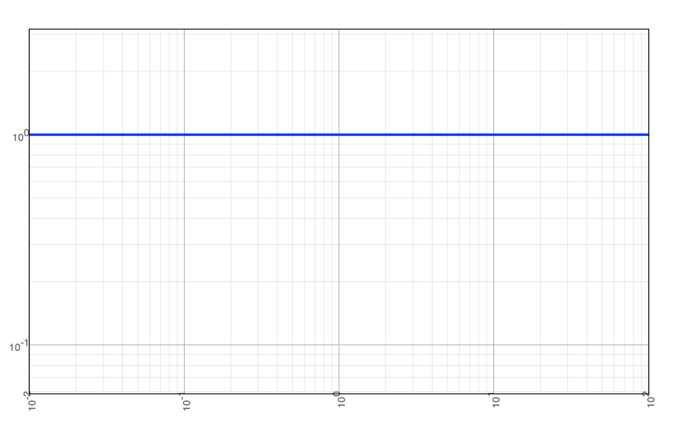
Types of filters
Types we frequently encounter in audio systems:
Lowpass
Highpass
Bandpass
Peaking / Notch
Shelving
Allpass

Slide 24
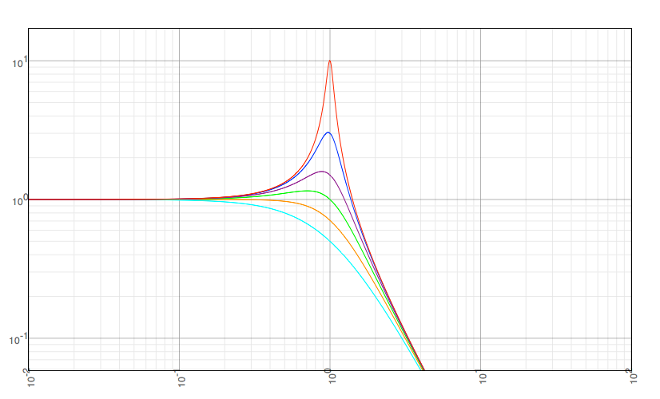
Filter Q
Filters can often be described by “quality factor” Q
Selectivity (bandwidth) relative to centre frequency
Q=Centre frequency / bandwidth = ω_{c}/B
Second order
lowpass resonator filters
Q = 0.5
Q = 0.71
Q = 1
Q = 1.5
Q = 3
Q = 10

Slide 25
Pole zero plot and square magnitude response for 4th order prototype low pass filter

Slide 26
Shifting the centre frequency of a low pass filter.
|H|²
1
1/2
0
π/2
π
Normalized frequency ω
|H|²
1
1/2
0
ω_{c}
π
Normalized frequency ω

Slide 27
Shelving filter transformation.
|H|²
|H|²
G²
1
1
1/2
0
π/2
π
0
ω_{c}
π/2
π
Normalized frequency ω
Normalized frequency ω

Slide 28
Pole zero plot (top) and square magnitude response for a fourth order prototype low shelving filter (bottom). Compared to our prototype filter, it moves the zeros towards the pole positions on the imaginary axis.
|H|²
N=2
1
N=4
N=1
1/2
0
π/2
π

Slide 29
Reversing the z domain to turn a lowpass into a high pass filter.
|H|²
0
π/2
π
|H|²
0
π/2
π

Slide 30
Transforming a low pass filter into a band pass filter.
|H|²
−π
π/2
0
π/2
π
|H|²
0
ω_{l}
ω_{c}
ω_{u}
π

Slide 31
Pole zero plot for a 1st order (top left) and 4th order (top right) low pass filter with center frequency w_{c}=p/4. On bottom, square magnitude response for the first order (solid line) and fourth order (dashdot line) filters.

Slide 32
Pole zero plot for a 1st order (top left) and 4th order (top right) high pass filter with center frequency w_{c}=p/4. On bottom, square magnitude response for the first order (dashdot line) and fourth order (solid line) filters.

Slide 33
Pole zero plot for a 1st order (top left) and 4th order (top right) low shelving filter with center frequency w_{c}=p/4 and gain at center frequency G=2. On bottom, square magnitude response for the first order (dashdot line) and fourth order (solid line) filters.

Slide 34
Pole zero plot for a 1st order and 4th order high shelving filter with w_{c}=p/4 and G=2. On bottom, square magnitude response for the first order (dashdot line) and fourth order (solid line) filters.

Slide 35
Pole zero plot for 2nd order (top left) and 8th order (top right) band pass filter with w_{c}=p/4 and B=p/8. Bottom, square magnitude response for the 2nd order (dashdot line) and 8th order (solid line) filters

Slide 36
Pole zero plot for 2nd order (top left) and 8th order (top right) band stop filter with w_{c}=p/4 and B=p/8. Bottom, square magnitude response for the 2nd order (dashdot line) and 8th order (solid line) filters

Slide 37
Pole zero plot for 2nd order (top left) and 8th order (top right) peaking filter with ω_{c}=π/4, B=π/8 and G=2. On bottom, square magnitude response for 2nd order (dashdot line) and 8th order (solid line) filters

Slide 38
Magnitude and frequency response for a particular allpass filter (first order, cutoff frequency of ω_{c}=π/4). All frequencies have unity gain but a different phase shift.

Slide 39
Block diagram for the first order digital allpass filter.
g
x[n]
+
y[n]
z⁻¹
+
-g

Slide 40
Filter implementation
Consider this filter:
What do we need to calculate values in real time?
Suppose we had a function that took one new value of x[n] and returned one new value of y[n]
float a1, a2, b0, b1, b2; // Assume these are initialised
float calculate(float x) {
float y;
y =
return y;
}
float yPrev, yPrevPrev, xPrev, xPrevPrev; // Previous samples
[what goes here?]
b0*x + b1*xPrev + b2*xPrevPrev + a1*yPrev + a2*yPrevPrev;
b0*x + b1*xPrev + b2*xPrevPrev + a1*yPrev + a2*yPrevPrev;
yPrevPrev = yPrev; // Need to remember old values...
yPrev = y; // Could also use a circular buffer
xPrevPrev = xPrev;
xPrev = x;

